Slide 1

Unit 4: Lesson 4
The colourful history of paint

Slide 2
Task 1: What is your favourite colour? Which shade?
Task 2: What do you get by mixing yellow and blue, red and blue and yellow and red?
green
purple
orange

Slide 3
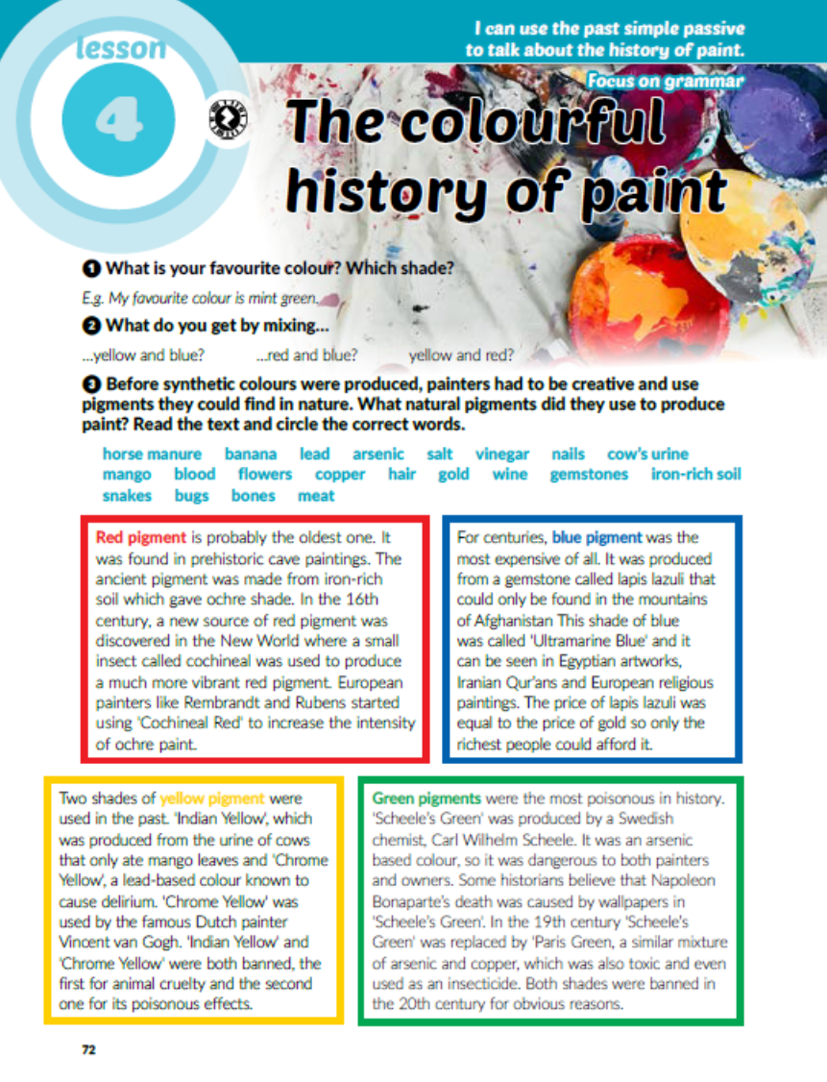
Task 3: Read the text and circle the natural pigments used to produce paint.

Slide 4
Task 1: Make 10 sentences.
Red pigment was found in prehistoric paintings.
Red pigment was made from iron-rich soil and cochineal insects.
Blue pigment was used in religious paintings.
Blue pigment was called Ultramarine Blue.
Blue pigment was produced from a gemstone called lapis lazuli.
'Indian Yellow' and 'Chrome Yellow' were produced from the urine of cows and lead, respectively.
'Indian Yellow' and 'Chrome Yellow' were banned for animal cruelty and poisonous effects.
Green pigments were called Scheele’s Green and Paris Green.
Green pigments were produced from a mixture of arsenic and heavy metals.
Scheele’s Green was replaced by Paris Green in 19th century.
Scheele’s Green was named a Swedish chemist.
Black pigment was produced by burning animal bones.
'Lead White' was produced from horse manure, vinegar and lead.
'Lead White' was banned in the 20th century.
'Lead White' was used to depict light in paintings.

Slide 5
Zapiši u bilježnicu
Past simple passive
Form: was/were + past participle
A: Somebody robbed my house last night.
P: My house was robbed last night.
A: The police caught the robbers.
P: The robbers were caught by the police.

Slide 6
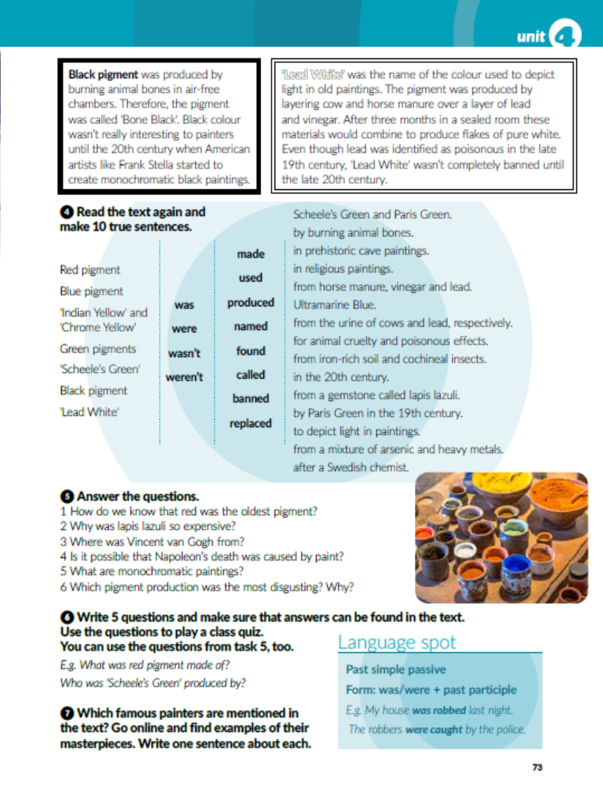

Slide 7

Task 6: Write 5 questions and give short answers. Send them to your teacher so you can make an online quizz.
Task 7: Which famous painters are mentioned in the text? Go online and find examples of their masterpieces. Write one sentence about each.

Slide 8
workbooks, page 75
Task 1: Sort out the shades into the table.
corn crimison denim lavander eggshell midnight
gold mint ruby navy plum ivory onyx
honey shamrock brick azure magenta cotton raven

Slide 9
Task 2: Circle the correct answer.

Slide 10
Task 3: Make true sentences.
1 Harry Potter books were written by J.K. Rowling.
2 Famous operas Aida and Nabucco were composed by Giuseppe Verdi.
3 Songs like Yesterday and Yellow Submarine were sung by the Beatles.
4 The Mona Lisa and The Last Supper were painted by Leonardo da Vinci.
5 The famous statue of David was created by Michelangelo.
6 The molecular structure of DNA was discovered by J. Watson and F. Crick.
7 The first automobile was invented by Carl Benz.
8 The Sydney Opera House was designed by Jørn Utzon.
9 Hit film A Star is Born was directed by Bradley Cooper.

Slide 11
Task 4: Complete the text with the past simple passive form of the verbs in brackets.
was written
wasn’t based
was first shown
was peformed
was released
was praised
weren’t convinced
was nominated

Slide 12
Task 5: Past simple active or passive? Circle the correct answer.

Slide 13
Task 6: Choose the correct answer.

Slide 14
Task 7: Go online and find out which colours are mentioned in these song titles.
Yellow
Brown
Yellow
Green
Green
Purple
Gold
White
Black
Black
Orange
Red
Blue
Yellow
White

Slide 15

PLAY AND LEARN!
https://www.e-sfera.hr/dodatni-digitalni-sadrzaji/cd695eb1-e344-42df-a945-38f76b6c0761/

